Slide 1
Developing with Power BI Embedding
Notes:
This module examines the architecture of Power BI embedding and demonstrates how to embed Power BI reports in a custom web application created using Visual Studio and ASP.NET MVC. The module explains the differences in application design between developing with the user-owns-data model versus the app-own-data model. The module demonstrates how to program using embed tokens and app-only authentication when developing with the app-owns-data model . The module will demonstrate developing custom web applications with a variety of Azure AD authentication flows including the Authorization Code Flow and Implicit Flow. Students will also learn how to get started writing client-side code with the Power BI JavaScript API to embed reports on a web page and to provide an interactive user experience.

Slide 2
Agenda
Power BI Embedding Overview
Embedding with App-Owns-Data Model
Caching Access Tokens using OWIN Middleware
Embedding with the User-Owns-Data Model
Developing with the Power BI JavaScript API

Slide 3
Power BI Embedding – The Big Picture
User launches your app using a browser
App authenticates with Azure Active Directory and obtains access token
App uses access token to call to Power BI Service API
App retrieves data for embedded resource and passes it to browser.
Client-side code uses Power BI JavaScript API to create embedded resource
Embedded resource session created between browser and Power BI service
5
Power BI Service
Browser
iFrame
6
4
4
3
1
Your App
2
Azure AD

Slide 4
First Party Embedding vs Third Party Embedding
First Party Embedding
Known as User-Owns-Data Model
All users require a Power BI license
Useful in corporate environments
App authenticates as current user
Your code runs with user’s permissions
User’s access token passed to browser
Third Party Embedding
Known as App-Owns-Data Model
No consumers require Power BI license
Useful for commercial applications
App authenticates with app-only identity
Your code runs with admin permissions
Embed token passed to browser
First Party Embedding for use within Organization
Third Party Embedding for use by ISVs
Browser
Power BI Service
Browser
Power BI Service
iFrame
iFrame
Azure AD
Access Token
for the current user
Power BI
Embed Token
for specific report

Slide 5
Agenda
Power BI Embedding Overview
Embedding with App-Owns-Data Model
Caching Access Tokens using OWIN Middleware
Embedding with the User-Owns-Data Model
Developing with the Power BI JavaScript API

Slide 6
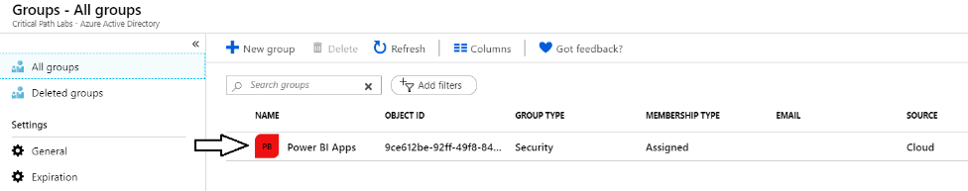
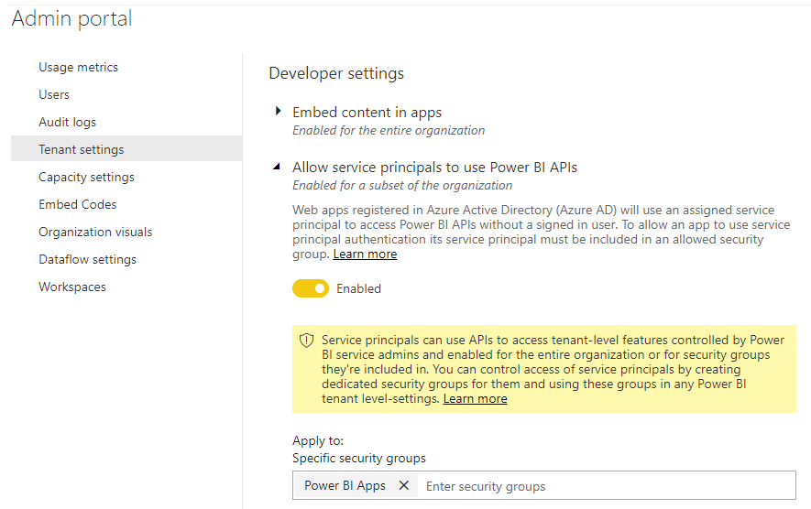
Setting Up for App-Owns-Data – Part 1
Enable Service Principal Access to Power BI Service API
Create an Azure AD security group (e.g. Power BI Apps)
Add group to Power BI Allow service principals to use Power BI APIs

Slide 7
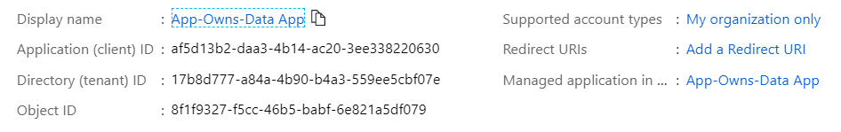
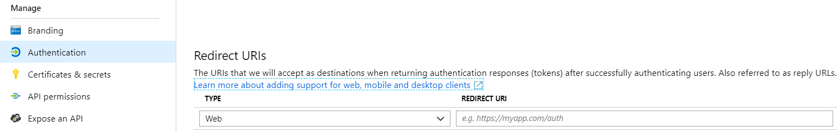
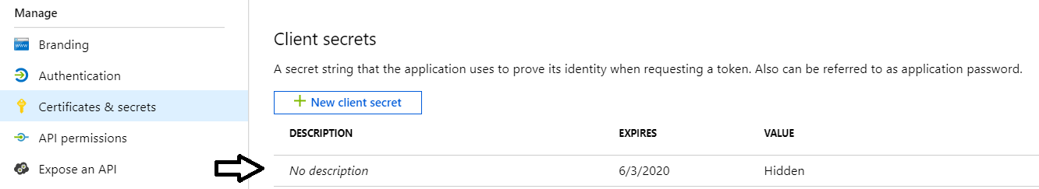
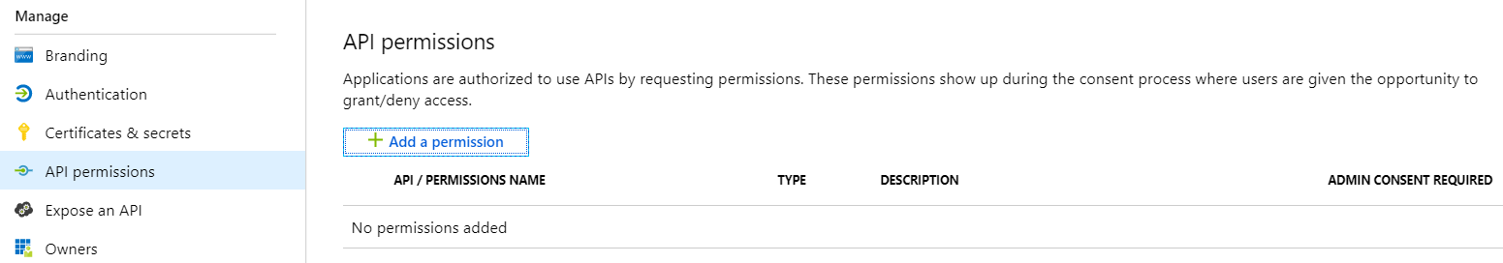
Setting Up for App-Owns-Data – Part 2
Create a confidential client in your Azure AD tenant
Configured as TYPE=Web and no need for a redirect URL
Add a client secret or a client certificate
No need to configure any permissions

Slide 8
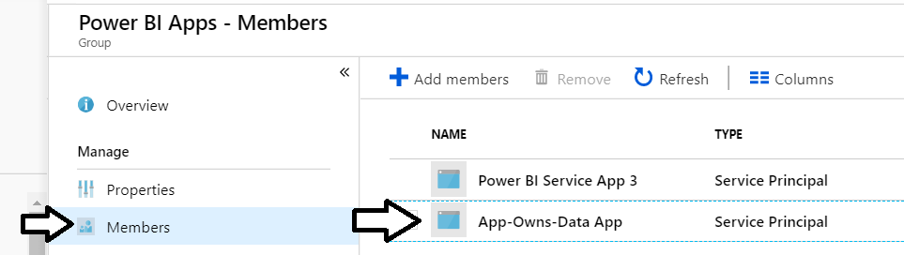
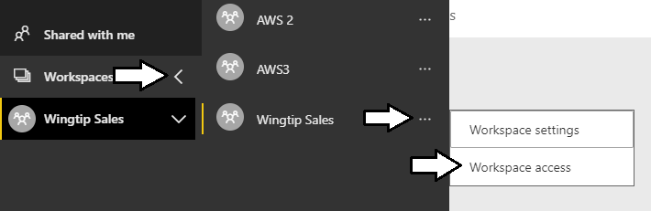
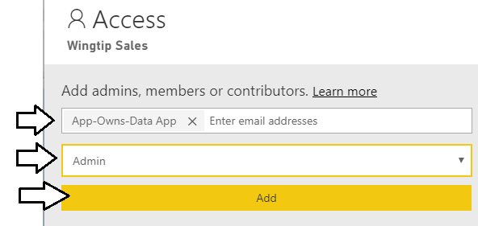
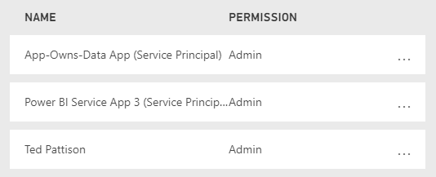
Setting Up for App-Owns-Data – Part 3
Add application's service principal in Power BI Apps security group
Configure application's service principal as workspace admin
Service principal should now be workspace admin

Slide 9
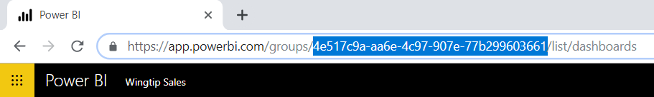
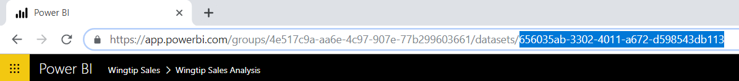
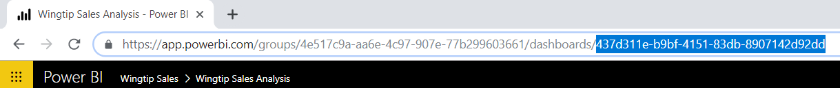
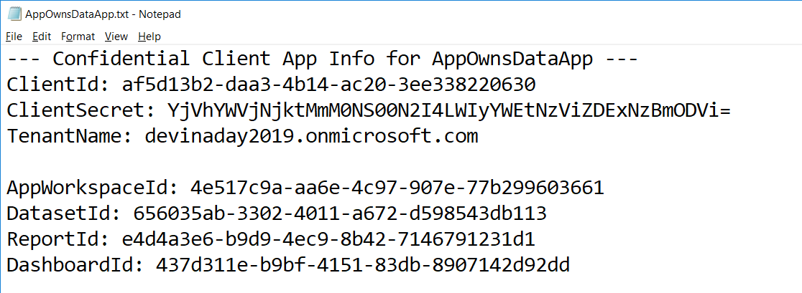
Setting Up for App-Owns-Data – Part 4
Record the GUIDs for your embeddable resources
Gather all configuration data which will be required by application

Slide 10
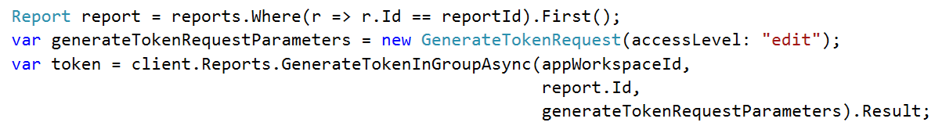
Generating Embed Tokens
You can embed reports using an AAD token, but…
You might want embed resource using more restricted tokens
You might want stay within the bounds of Power BI licensing terms
You generate embed tokens with the Power BI Service API
Each embed token created for one specific resource
Embed token provides restrictions on whether user can view or edit
Embed token can only be generated in dedicated capacity (semi-enforced)
Embed token can be generated to support row-level security (RLS)

Slide 11
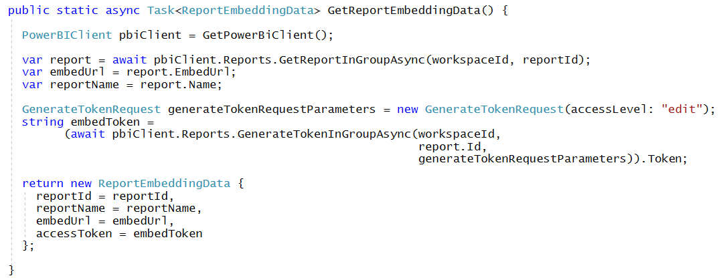
Getting the Data for Report Embedding

Slide 12
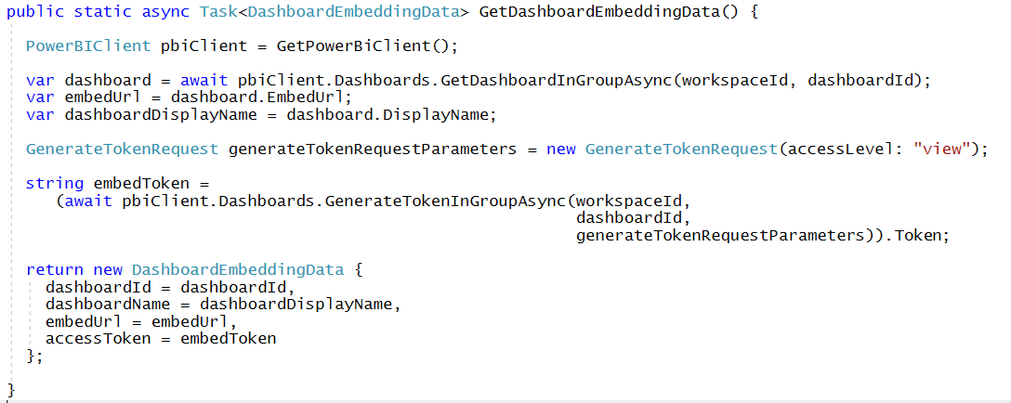
Getting the Data for Dashboard Embedding

Slide 13
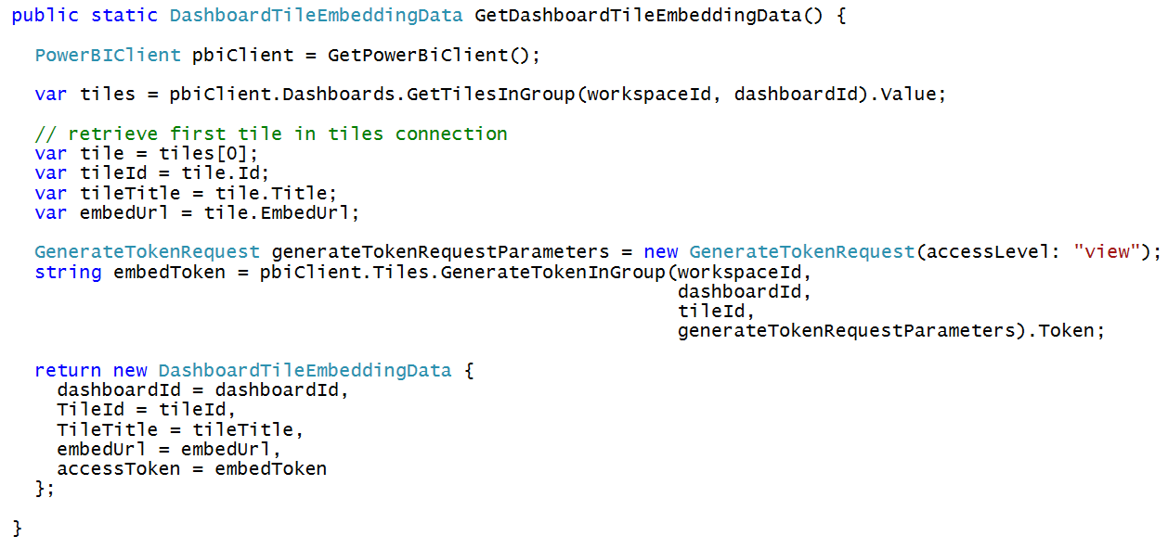
Getting the Data for Tile Embedding

Slide 14
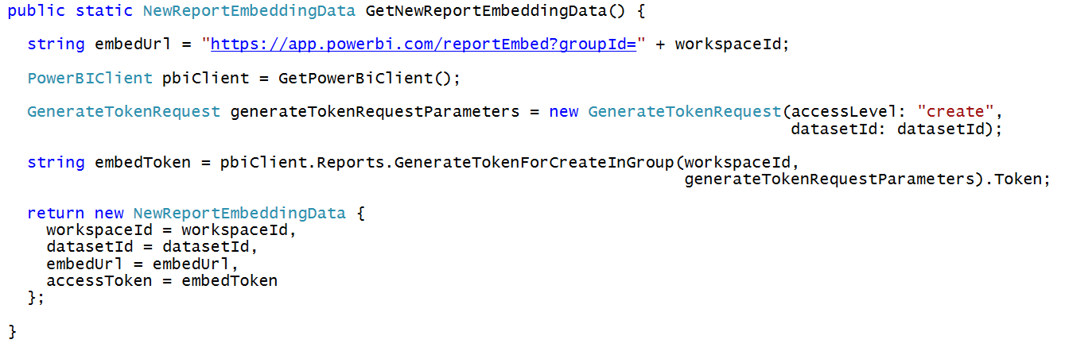
Getting Data for New Report Embedding

Slide 15
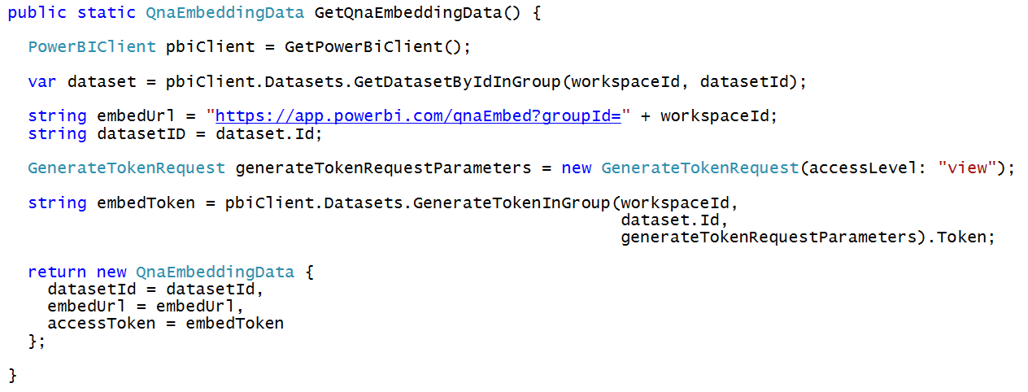
Getting the Data for Q&A Embedding

Slide 16
Agenda
Power BI Embedding Overview
Embedding with App-Owns-Data Model
Caching Access Tokens using OWIN Middleware
Embedding with the User-Owns-Data Model
Developing with the Power BI JavaScript API

Slide 17
Open Web Interfaces for NET (OWIN)
OWIN interfaces decouple web server from application
OWIN serves to decouple .NET applications from Windows and IIS
OWIN promotes the development of smaller modules (middleware)
Microsoft's Implementation known as Katana
Makes it possible to use OWIN with ASP/NET and ASP Core
Microsoft provides OWIN-based security middleware
Your Web Application
Katana (OWIN implementation for ASP.NET)
OWIN
Web Server and OS

Slide 18
OWIN Middleware Modules
OWIN create pipeline of middleware components
Middleware components added to pipeline on application startup
Middleware components pre-process and post process requests
Middleware components commonly used to set up authentication
OWIN Middleware Pipeline
Browser
Middleware
Component 1
Middleware
Component 2
Web
Application
request
response

Slide 19
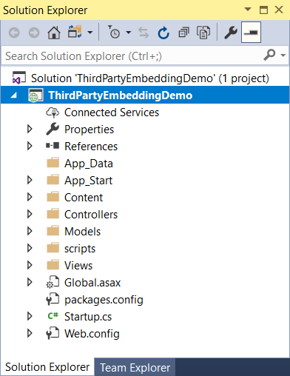
ThirdPartyEmbeddingDemo
Demonstration key points
Entity Framework Identity Provider
OWIN Security module
OWIN Middleware Pipeline
Browser
OWIN
Security
Cookies
OWIN
Identity Provider
Entity Framework
Web
Application
request
response

Slide 20
Agenda
Power BI Embedding Overview
Embedding with App-Owns-Data Model
Caching Access Tokens using OWIN Middleware
Embedding with the User-Owns-Data Model
Developing with the Power BI JavaScript API

Slide 21
Authorization Code Grant Flow
Sequence of Requests in Authorization Code Grant Flow
Application redirects to AAD authorization endpoint
User prompted to sign in using Windows logon page
User prompted to consent to permissions (first access)
AAD redirects to application with authorization code
Application calls to AAD token endpoint to acquire access token
Request authorization code
Sign-in via browser pop-up
Return authorization code
Pass authorization code to acquire access token for Power BI Service resource
Return access token and refresh token
Call Power BI Service API using the access token
Return Http Response
Authorization Endpoint
Token Endpoint
Client Application
Power BI Service API

Slide 22
OWIN OpenID Connect Module
OpenID Connect module used to implement Authorization Code Flow
Redirects browsers to authorization endpoint
Provides notification when receiving authorization code callback
OWIN Middleware Pipeline
Browser
OWIN
Security
Cookies
OWIN OpenID Connect
Web
Application
request
response

Slide 23
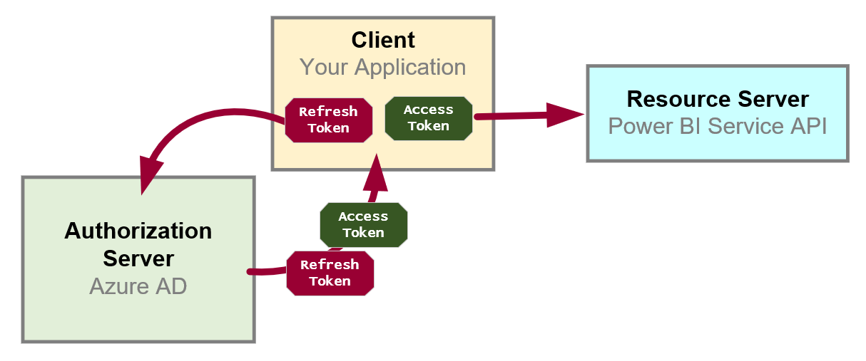
Token Caching and Refresh Tokens
OAuth 2.0 provide solution for access token expiration
Access tokens have default lifetime of 60 minutes
Authorization server passes refresh token along with access token
Refresh token used as a credential to redeem new access token
Refresh token default lifetime is 14 days (max 90 days)
Refresh tokens often persistent in database or browser storage
ADAL and MSAL both offer built-in support to mange token caching

Slide 24
DailyReporterPersonal

Slide 25
Understanding Implicit Flow
Single Pages Applications (SPAs) are public clients
SPA not able to keep secrets such as application secret
No ability to execute server-to-server calls
SPAs cannot implement authorization code flow
Implicit flow requires lowering security bar for SPAs
Azure AD application must be configured to allow implicit flow
Allows SPAs to retrieve access tokens
Access token returned to browser in URL fragment

Slide 26
PowerBIDaySPA

Slide 27
Agenda
Power BI Embedding Overview
Embedding with App-Owns-Data Model
Caching Access Tokens using OWIN Middleware
Embedding with the User-Owns-Data Model
Developing with the Power BI JavaScript API

Slide 28
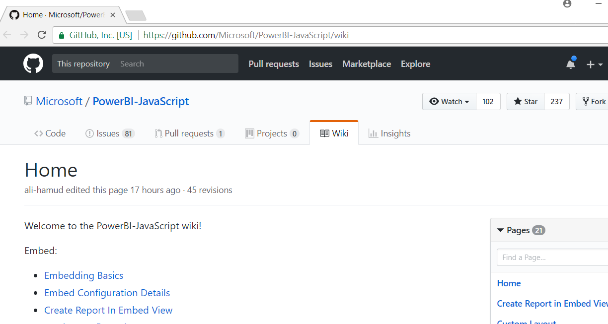
Power BI JavaScript API (powerbi.js)
Power BI JavaScript API used to embed resources in browser
GitHub repo at https://github.com/Microsoft/PowerBI-JavaScript/wiki
GitHub repository contains code, docs, wiki and issues list

Slide 29
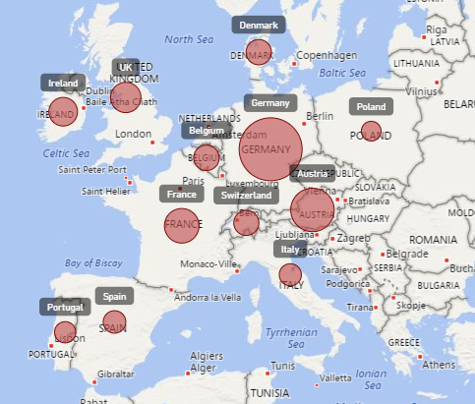
Report Embedding Architecture
Embedding involves creating an iFrame on the page
PBIJS transparently creates iFrame and sets source to Power BI Service
The iFrame and hosting page originate from different DNS domains
Your HTML and CSS
https://app1.mydomain.com
Web Hosting Server
Your
JavaScript
iFrame
Embedding Data
https://wabi-us-east2-redirect.analysis.windows.net/
powerbi.js
Power BI Service

Slide 30
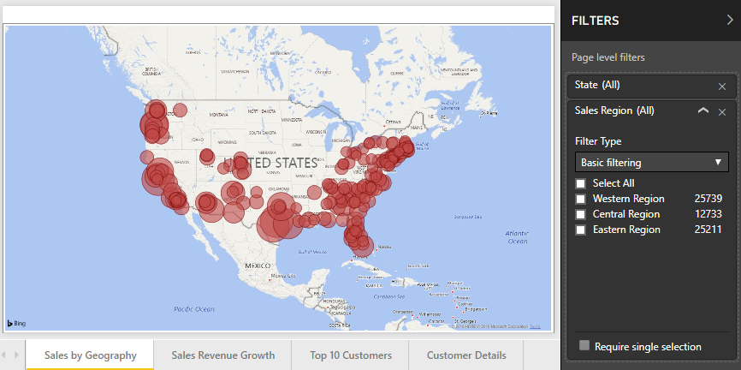
Post Message Communications Flow
4 extra libraries used communicate with report in iFrame
window-post-message-proxy (WPMP)
http-post-message (HPM)
powerbi-router (PBIR)
powerbi-models (PBIM)
iFrame
Your
JavaScript
service
report
HPM
PBIR
WPMP
WPMP
PBIR
HPM

Slide 31
A Promise-based Programming Model
Design of PBIJS simulates HTTP protocol
Creates more intuitive programming model for developers
Programming based on asynchronous requests and promises
Embedded objects programmed using actions and events
Actions
report.fullscreen
report
report.switchMode
report.setFilters
Your
JavaScript
report.getPages
Events
report.loaded
report.pageChanged
report.commandTriggered

Slide 32
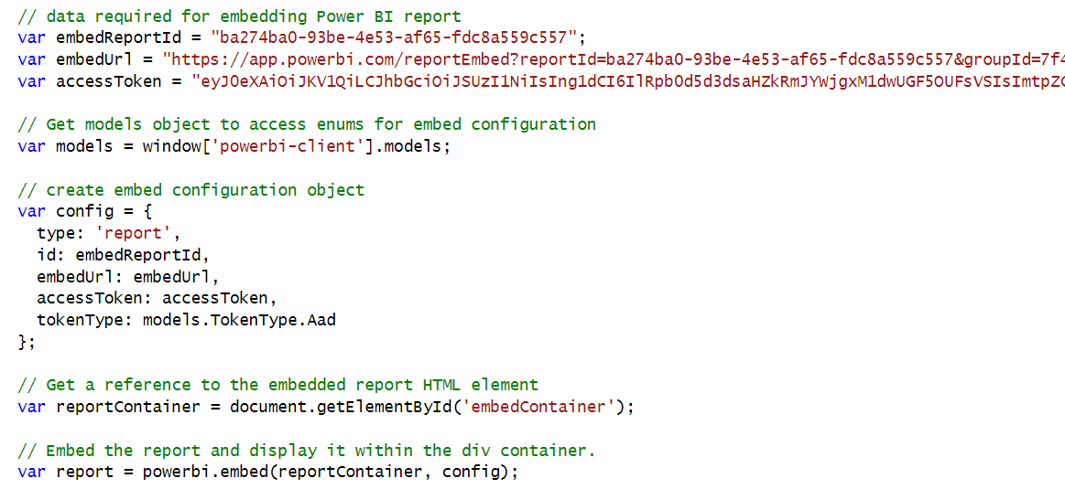
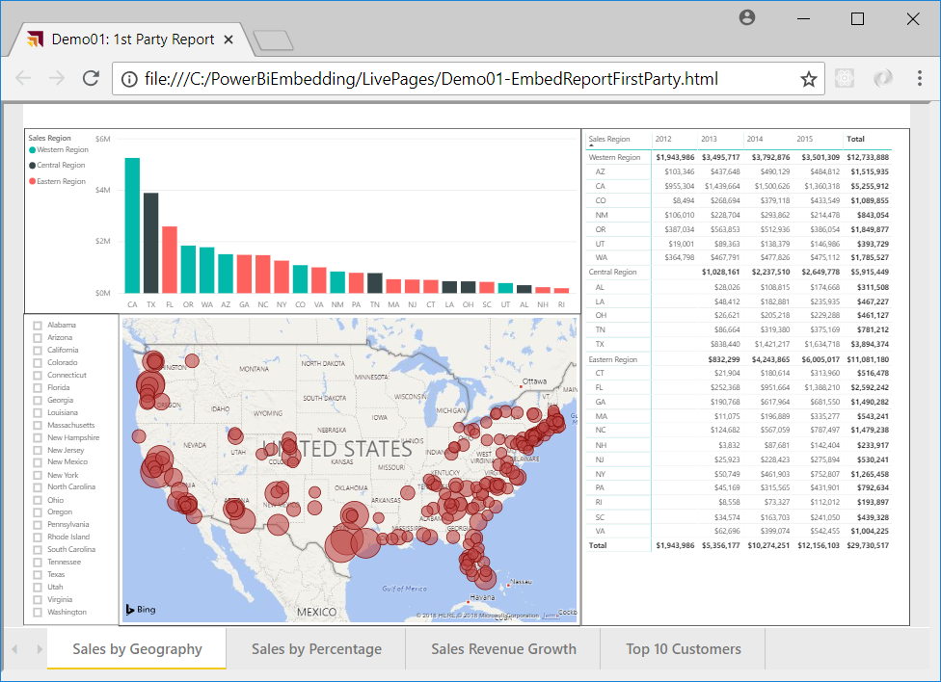
Hello World with Power BI Embedding
powerbi.js library provides powerbi as top-level service object
You call powerbi.embed and pass configuration object with access token
models object available to supply configuration settings
configuration object sets tokenType to either TokenType.Embed or TokenType.Aad
First party embedding

Slide 33
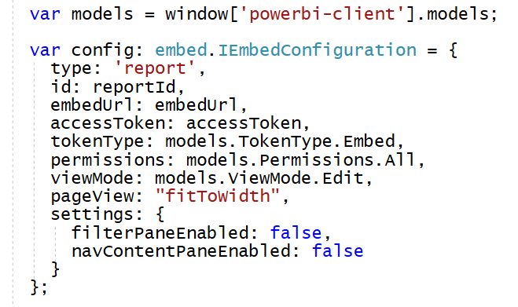
Embedded Report Configuration Options
permissions determines what permissions are given to user on resource
viewMode determines when report opens in read-only view or edit view
pageView determines how reports scales to fit embed container element
Read: Allows view report only.
ReadWrite: Allows view, Edit and Save report.
Copy: Allows Save a copy of a report using Save As.
Create: Allows creating a new report.
All: Allows everything.
View - Opens report in View mode.
Edit - Opens report in Edit mode.
fitToWidth: Fit to width of host HTML element.
oneColumn: Opens in single column.
actualSize: Actual size as designed in report

Slide 34
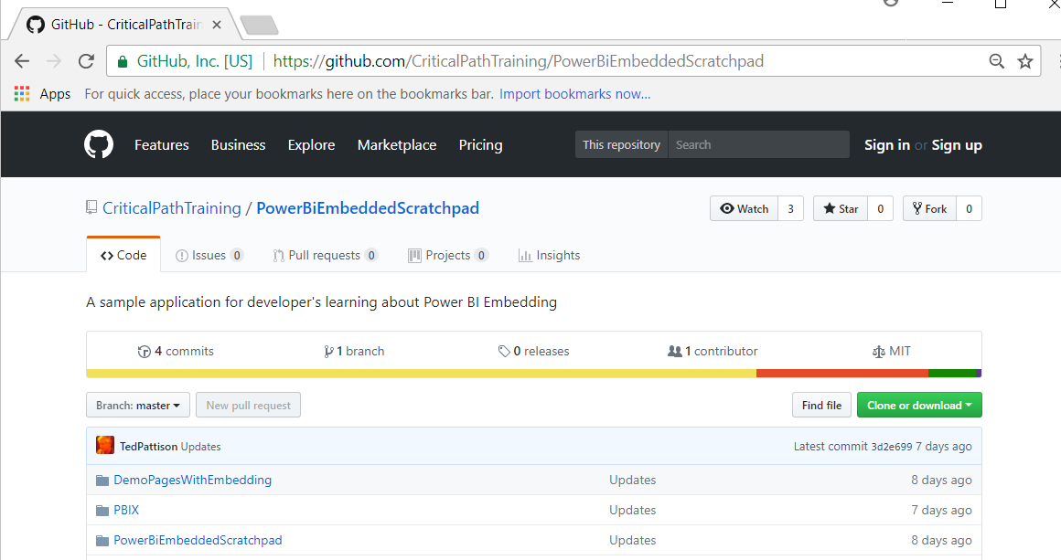
PowerBiEmbeddedScratchpad Sample
https://github.com/CriticalPathTraining/PowerBiEmbeddedScratchpad

Slide 35
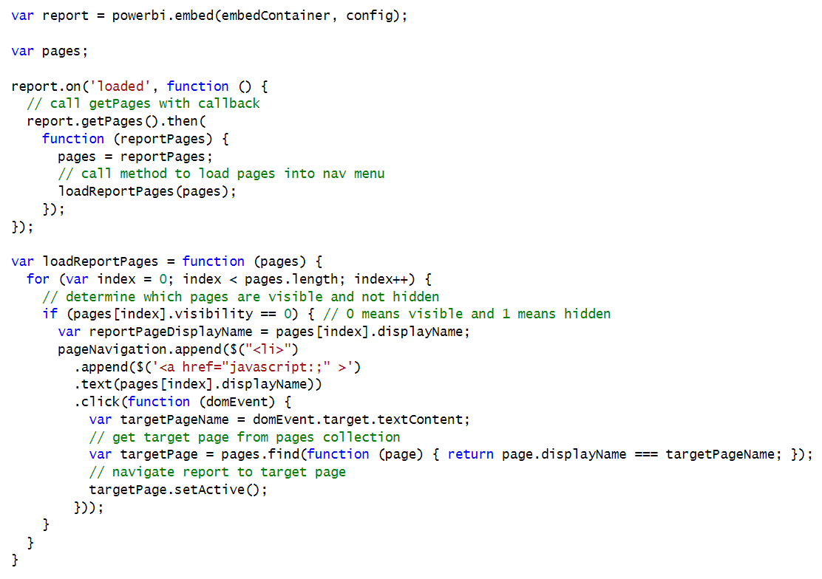
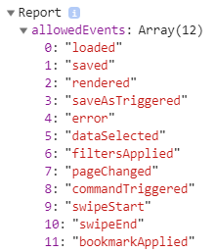
Handling Report Events

Slide 36
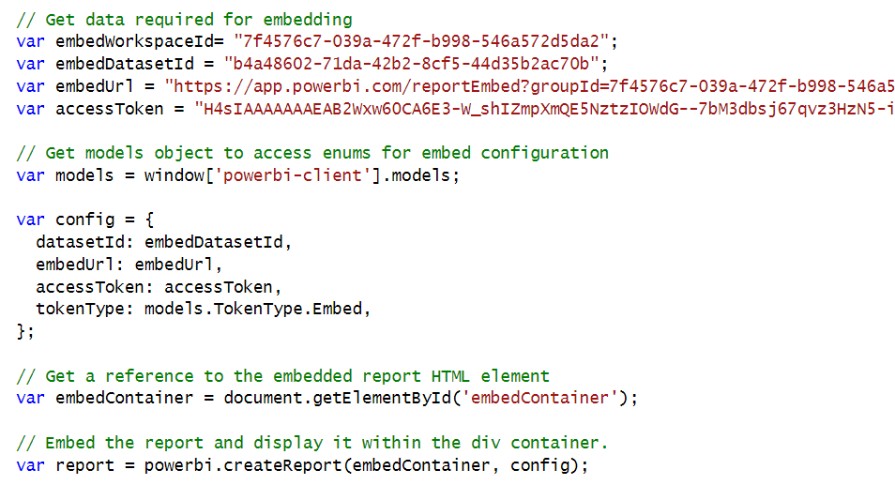
Embedding a New Report

Slide 37
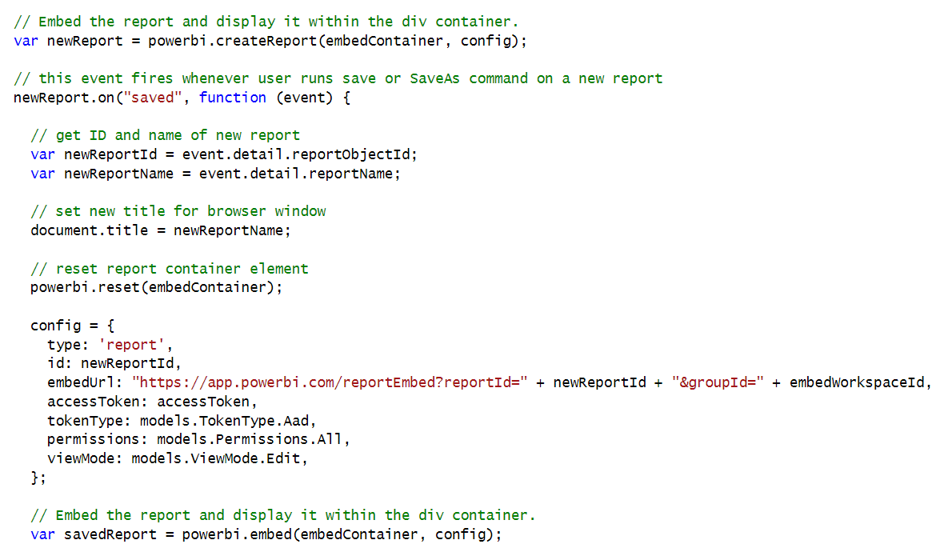
New Report with SaveAs Redirect

Slide 38
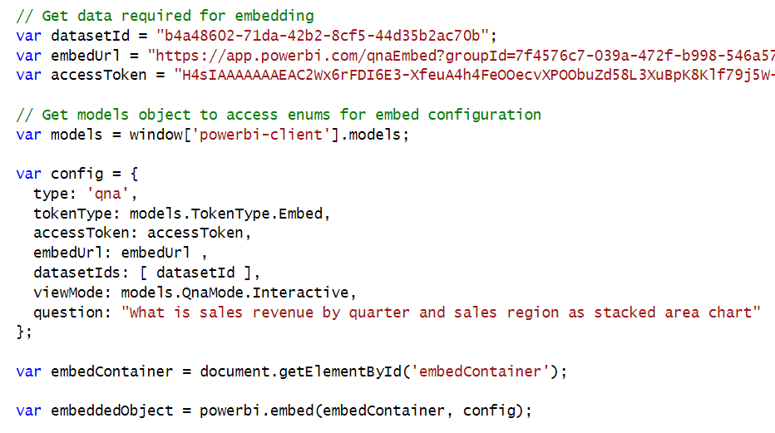
Embedding the Q&A Experience

Slide 39
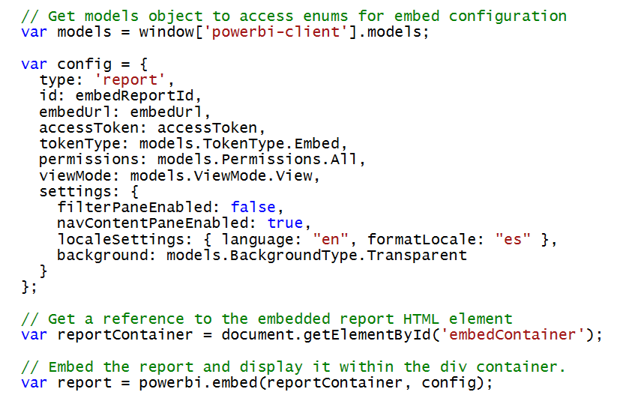
Configuration Options

Slide 40
The Power BI Embedded Scratchpad App

Slide 41
Summary
Power BI Embedding Overview
Embedding with App-Owns-Data Model
Caching Access Tokens using OWIN Middleware
Embedding with the User-Owns-Data Model
Developing with the Power BI JavaScript API

